Slide 1
DSC3013 Intro. to Social
Media Analytics (Lec. 4)
Hao PENG
Department of Data Science
City University of Hong Kong
https://haoopeng.github.io/

Slide 2
Agenda
1. The importance of text mining in SMA
2. Regex fundamentals and Python's re package
3. Some good examples – Mining news articles
4. Beyond regex: Language Style Matching
5. Beyond regex: Sentiment Analysis (Recap 2005)
6. In-class exercises

Slide 3
Why Text Mining in Social Media?
- Most social media data is unstructured text
- Manual reading does not scale to millions of posts
Text mining enables:
- Named entity recognition
- Keyword extraction / filter data
- Text cleaning, topic detection
- Quote attribution, mention
- Linguistic style analysis
- Sentiment analysis

Slide 4

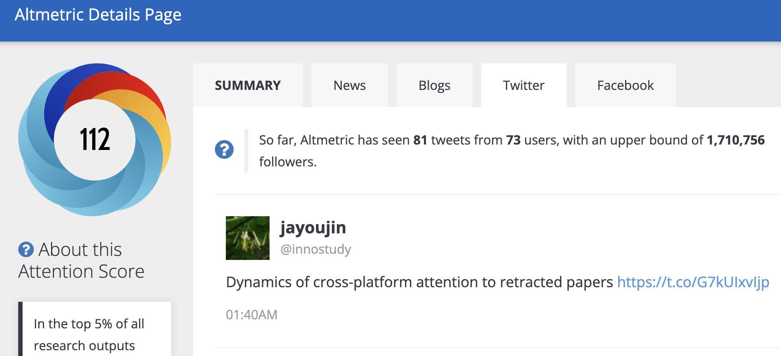
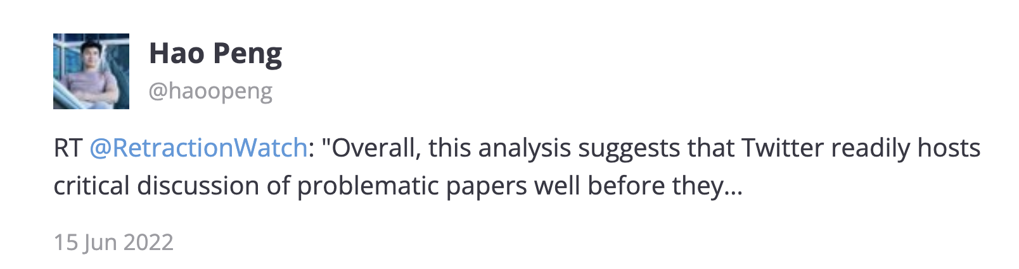
Detect self-promotion on Twitter
Notes:
This is one paper which has received 7K tweet mentions.

Slide 5
Matching names to usernames
Notes:
This is one paper which has received 7K tweet mentions.

Slide 6
Pure string matching
How to detect if an author self-promoted their paper?
  Token-matching: ﬁrst or last name of author should be matched to tokens of usernames (split by space, underscore).
  Containment-matching: only if the tweet names are single-token strings and the ﬁrst/last name has >= four characters.
In what prediction tasks, would this variable be useful?
How to deal with complex cases like detecting quotes in news?
Notes:
Predict num of tweet mentions or news coverage.

Slide 7
What Are Regular Expressions?
Definition:
A regular expression (regex) is a sequence of characters that defines a search pattern. Used to match, search, extract, or replace text.
Regex benefits:
- Precise pattern matching (emails, URLs, hashtags, mentions)
- Fast pre-processing before NLP models
- Lightweight alternative to full NLP pipelines
e.g., we don’t need to use Newspaper package to process the whole document if we only want to detect author mentions in news articles.
- Works across any language and platform

Slide 8
Regular Expressions (or 'regex')
Concise, flexible pattern matching expressions
Match substrings of text (words or complex patterns)
Appear in many tools
    grep (command line), text editors, ….
Therefore, useful to learn!

Slide 9
The Python re module
Search/match operations:
re.search() finds first match anywhere in string (match object)
re.match() finds first match at beginning of string (match object)
re.findall() finds all matches anywhere in a string (list of strings)
re.finditer() finds all matches anywhere in a string (iterator of match objects)
Regex-enabled string operations:
re.split() splits strings at all occurrences of a pattern
re.sub() replaces (substitutes) all occurrences of a pattern

Slide 10
re.search
search(pattern, string, flags=0)
Scan through string looking for the first match to pattern
Return:
- If something is found: a Match object
- If nothing is found: None

Slide 11
re.match
match(pattern, string, flags=0)
Check if pattern matches at the beginning of string
Return:
- If something is found: a Match object
- If nothing is found: None

Slide 12
Most methods return match objects
import re
lazy = 'The lazy dog went to sleep'
result = re.search('dog', lazy)
if result is not None:
print('found', result.group() )
else:
print('did not find')
match objects:
group() Contents of the match
start() Start position of match
end() End position of match
found dog

Slide 13
Basic matching patterns
Ordinary characters just match themselves
result = re.search('dog', 'The lazy dog went to sleep’)
Many reserved special characters, including:
. ^ $ * + ? { }[ ] | ( ) \
And escape sequences that begin with “\”:
  \t tab
  \n newline
  \r return
https://developers.google.com/edu/python/regular-expressions

Slide 14
Symbols for matching single char
. Any char (except newline = \n)
'F..m:'
'Farm:' -> Yes
'Foom:' -> Yes
'Firm!' -> No

Slide 15
Symbols for matching single char
\s Whitespace
'Pine\sapple'
'Pine apple' -> Yes
'Pine\tapple' -> Yes
'Pineapple' -> No
\S Non-whitespace
'Pine\Spple'
'Pineapple' -> Yes
'Pine pple' -> No
\d Digit, 0-9
'Apple \d\d\d'
'Apple 123' -> Yes
'Apple ABC' -> No
'Apple 12C' -> No
\D Non-digit
'Apple \D\D\D'
'Apple ABC' -> Yes
'Apple 123' -> No
Example: \d{4} matches exactly four digits (e.g., a year)

Slide 16
Symbols for matching single char
\w "word” or “regular” character
(letter, digit, underscore: [a-zA-Z0-9_]
'cat\w'
'cats' -> Yes
'cat3' -> Yes
'cat!' -> No
\W Non-"word" character
'cat\W'
'cats' -> No
'cat!' -> Yes
\b word boundary
(beginning or end of word)
'\bcat\b'
'cats' -> No
'cat3' -> No
'cat!' -> Yes
\B Not beginning/end of word
'\Bcat\B'
'cats' -> No
'meercats' -> Yes

Slide 17
Symbols for matching single char
^ Beginning of a line
'^From:'
'From: Matt’ -> Yes
'It said, From: …' -> No
$ End of a line
'Michigan$'
'Michigan, USA' -> No
'Michigan\nUSA' -> Yes
Example: ^(RT @\w+) matches retweet prefixes at start of tweet

Slide 18
Why use \B instead of \w?
re.search(r'\wcat\w', 'meercats')
<_sre.SRE_Match object; span=(4, 7), match='rcats'>
re.search(r'\Bcat\B', 'meercats')
<_sre.SRE_Match object; span=(4, 7), match='cat'>

Slide 19
Escape special symbols with \
What if we really want to look for '$' or '.' or '\' ?
Use an escape sequence: backslash + special char
e.g. '\$'
Examples:
'\$19\.99’ will match '$19.99'
'\\folder' will match '\folder'

Slide 20
Quantifiers: match multiple chars
* zero or more of the previous thing
+ one or more of the previous thing
? zero or one of the previous thing
{3} exactly 3 of the previous thing
{3,6} between 3 and 6 of the previous thing
{3,} 3 or more of the previous thing

Slide 21
Repeating pattern examples
ab* will match
- 'a' (must have)
- followed by zero or more 'b's
ab+ will match
- 'a' (must have)
- followed by one or more 'b's (will not match just 'a')
ab? will match
- 'a' (must have)
- followed by zero or one 'b's

Slide 22
A set of characters: [ ]
[aeiou] A single character in the set {a, e, i, o, u}
[^aeiou]A single character not in set {a, e, i, o, u}
Example:
What substrings does [aeiou]{2,} match in this text?
The eerie wind said "Oooo" and "Rrr".
The eerie wind said "Oooo" and "Rrr".

Slide 23
Define a range with dash “-”
Valid:
[A-Z] Upper Case Roman Alphabet
[a-z] Lower Case Roman Alphabet
[A-Za-z] Upper Case and Lower Case
[A-F] Upper Case (but only A – F)
[0-9] \d
[a-zA-Z0-9_] \w
Invalid:
[a-Z]
[F-A]
[9-0]

Slide 24
Negation of ranges
  [^0-9] Anything BUT digits
  [^a] Anything BUT a lower case a
  [^A-Z] Anything BUT upper case letters
  [^,] Anything BUT ,

Slide 25
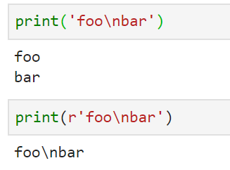
Raw string notation: r'text'
(Python uses “\” to escape special characters)
What if we really want to look for the backslash char?
Solution: prefix string with r
'\n' one-char string
containing just newline character
r'\n' two-char string
containing \ and n characters

Slide 26
Greedy matching: The Default
Greedy: matching as much as possible in the given string.
Example:
s = 'the cat in the hat'
match = re.search(r'^(.*)(at)(.*)$', s)
Note: () is used for matching multiple groups!
Now, what do we have in three groups:
match.group(1), match.group(2), match.group(3)?
'the cat in the h’ 'at’ ''
Notes:
There is no backslash in the r-string, so it is the same as regular RE.

Slide 27
Non-greedy matching by adding an extra ? to the end of wildcard
Non-greedy versions try to match as minimally as possible.
??, *?, +?, and {}?
Example:
s = 'the cat in the hat'
match = re.search(r'^(.*?)(at)(.*)$', s)
Now, what do we have in three groups:
match.group(1), match.group(2), match.group(3)?
'the cat in the h' 'at' ''
'the c' 'at' 'in the hat'

Slide 28
Defining alternatives using pipe |
  Use alternatives in regular expressions by putting them in brackets:
  (success|failure code: [0-9]+|maybe[!?]*)
Pipe is never greedy. As the target string is scanned:
  patterns separated by '|' are tried from left to right.
  When one pattern completely matches, that branch is accepted.
  Once A matches, B will not be tested further
  Even if it would produce a longer overall match.
What does this match? ^(T|t)oday
Notes:
Start with either a capital T or lowercase t. Are followed immediately by the exact characters “oday”. Must appear at the start of the string.

Slide 29
Optional parameters
The option flag can be added as an extra argument.
  e.g., re.search(pat, str, re.IGNORECASE)
re.IGNORECASE: Ignore upper/lowercase differences.
re.DOTALL: Make the '.' special character match any character at all, including a newline (by default, the '.' matches anything except a newline).
re.MULTILINE: Within a multi-line string, let ^ and $ match the start and end of each line. Normally ^/$ match the start and end of the whole string.

Slide 30
Useful Patterns in SMA
Target
Regex pattern
Hashtag
#\w+
Mention
@\w+
URL
https?://\S+
Email
[\w.]+@[\w.]+\.\w+
Retweet prefix
^RT @\w+:
Date (YYYY-MM-DD)
\d{4}-\d{2}-\d{2}
Use case: Align posts with external events (elections, disasters).

Slide 31
Compiling Patterns for Efficiency
import re
hashtag = re.compile(r"#\w+")
result = hashtag.findall("Great talk with @jane_doe about #AI #Ethics")
print(result)
# ['#AI', '#Ethics']
Why compile?
- Reuse the same pattern many times
- Faster on large datasets
- Cleaner, more readable code

Slide 32
Extracting with Capture Groups
pattern = re.compile(r"@(\w+)")
users = pattern.findall("Thanks @alice and @bob for the RT")
print(users)
# ['alice', 'bob']
Capture groups isolate the part you actually want.

Slide 33
Replacing with re.sub()
text = "Check out https://t.co/abc123 for details"
clean = re.sub(r"https?://\S+", "[URL]", text)
print(clean)
# "Check out [URL] for details"
Common in preprocessing: strip URLs, mentions, or hashtags before modeling.

Slide 34
Application - Mention Networks
post = "Thanks @alice and @bob for the RT, cc @carol"
mentions = re.findall(r"@(\w+)", post)
Use case: Map who mentions whom; identify communities.

Slide 35
Application - Detecting Bots
bot_pattern = re.compile(r"^[A-Za-z]+\d{6,}$")
print(bool(bot_pattern.match("user1234567"))) # True
print(bool(bot_pattern.match("jane_doe"))) # False
Usernames ending in long digit strings are a common bot signal.

Slide 36
Application - Stock Names
tickers = re.findall(r"\$[A-Z]{1,5}\b", "Watching $AAPL and $TSLA")
Use case: Financial sentiment analysis on social media.

Slide 37
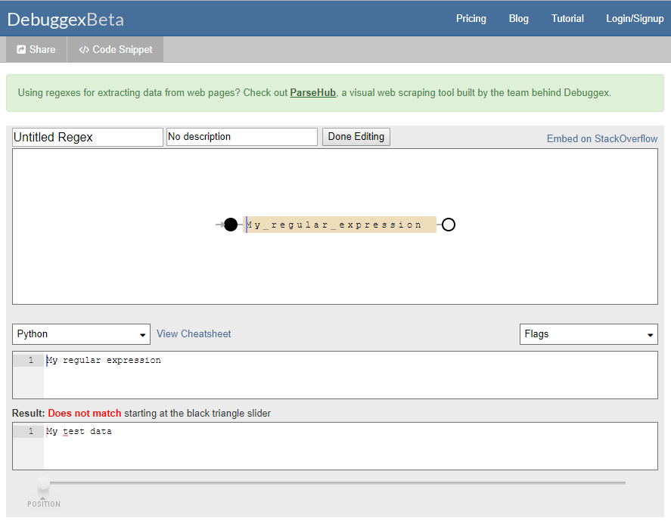
Useful online debugging tools
Visually test if code works in real-time: www.debuggex.com
Make sure to set this!

Slide 38
What you should know
Read/write regular expressions for matching patterns
How to use the Python re library functions to search for matches, extract them, substitute text for them
How to specify and extract groups in a match
Greedy vs. non-greedy matching

Slide 39
Content moderation on Reddit
Platforms employ regex for real-time content moderation.
  Reddit's use of patterns like (asshole|slur|abuse) to flag potentially harmful language in comments or posts.
This helps in filtering negative content by triggering reviews.
Such tools can help to maintain community standards through toxicity analysis in high-volume online social environments.

Slide 40
Cross-platform user identification
Use regex to identify links to other social media accounts.
  Extract Instagram handles in tweets: instagram\.com/[a-zA-Z0-9_]+
  Revealing user interests and user migration.
Helpful for tracking user behaviors across platforms.
  Taobao product recommendation based on post viewed on RedNote.
This simple technique is also valuable for analyzing how users share content across sites, which is good for viral marketing.

Slide 41

Case: Who are mentioned in science news
Notes:
To systematically investigate this issue, we did an obs study to answer two big RQs.

Slide 42
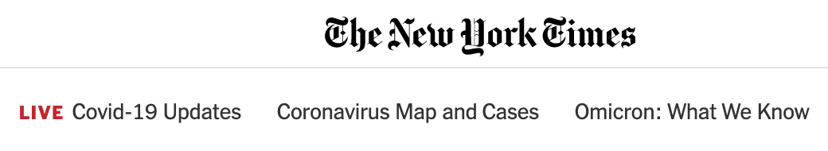
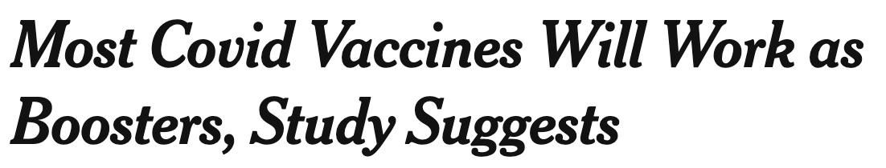
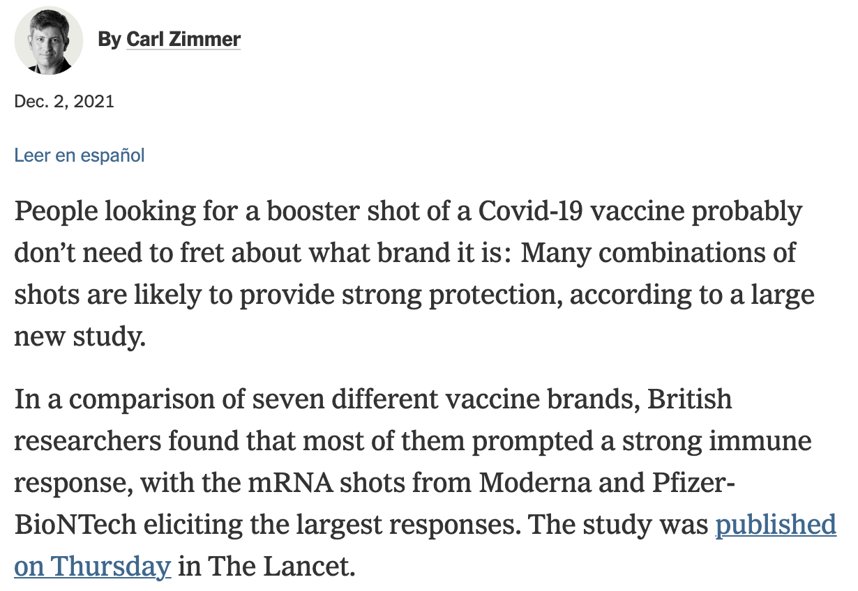
Not all authors are mentioned in news stories that report their research papers
Only last author is quoted in this story (omitted here due to space limitation)
Notes:
This story reports a paper, mentions the last author, but referred to all other authors as British researchers.
https://www.nytimes.com/2021/12/02/health/covid-booster-shots-mix-and-match.html

Slide 43

Not all authors are mentioned in news stories that report their research papers

Slide 44



Retrieved 520K stories mentioning 275K papers from 288 U.S.-based outlets
Microsoft Academic Graph
Analyzing text with NLP Tools
223K news stories (288 U.S. outlets) mentioning 100K papers;
Focused on the first, last, and any other corresponding authors;
524K (story, paper, author) triplets;
Notes:
In our final dataset

Slide 45
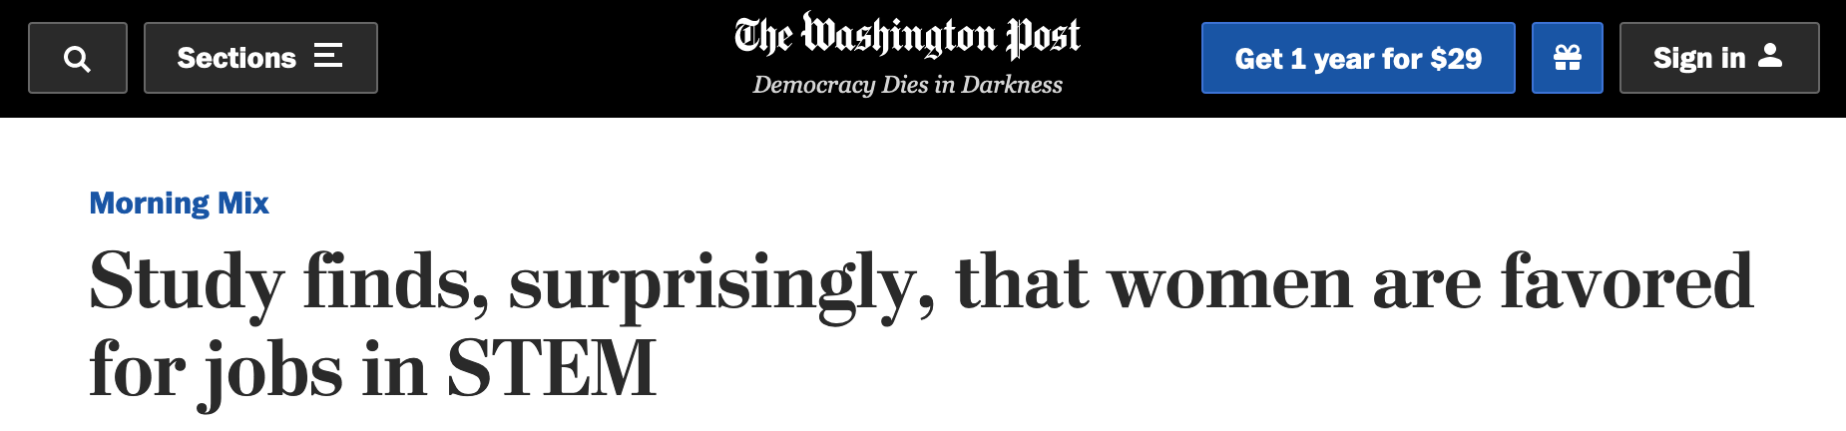
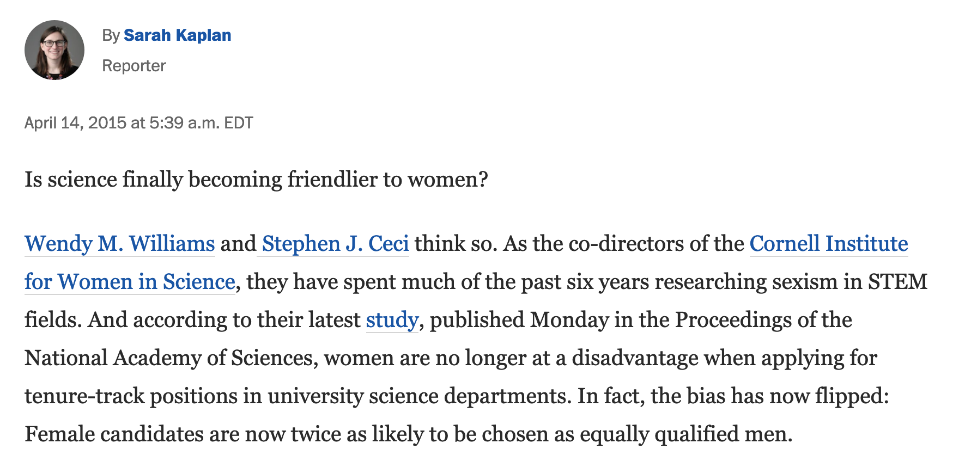
Analysis unit: (story, paper, author) triplet
Identified journalists in 18% of all stories (41 news outlets)
Used the newspaper3k
package or custom regex (41 domains) to extract full text news from HTML page
Detected author mentions in the story, which happened in 41% of all observations (triplets)
Notes:
We treated each triplet as an obs.

Slide 46

Test for bias in who gets mentioned
Logistic regression: Is the author mentioned in the given news story?

Slide 47
Design the regular expression
Search the author’s last name using a regular expression with word boundaries around the name, requiring that the name’s initial letter be capitalized.
How about the author named “Walter White”?
  News sentence “The city is famous for white color”.
  Would the above rule produce a false positive?
Special consideration for two Chinese last names “He”, “She”.
  They can appear as third person pronouns at the start of sentences.
  E.g., “She enjoys teaching social media courses.”
  Impose additional constraints for these two names such that they must be immediately preceded with one of the following titles to be considered as a name mention: “Professor”, “Prof.”, “Doctor”, “Dr.”, “Mr.”, “Miss”, “Ms.”, ‘Mrs.”
Notes:
While the chance exists that this process may introduce false positives for authors with common words as last names (e.g., “White”), such cases are rare because (i) few authors in our dataset have common English words as their last names, and (ii) these words rarely appear at the beginning of a sentence in the story when they would be capitalized.

Slide 48
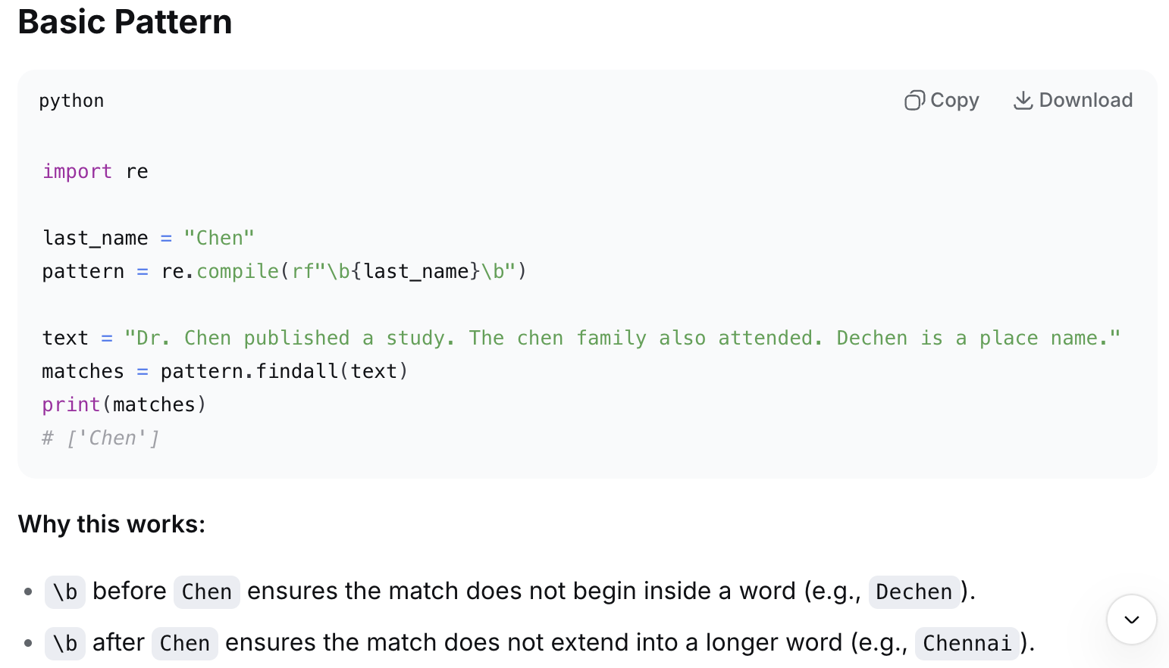
Code by DeepSeek

Slide 49
Identify news topics by politicians
Extract text in quotation marks that follow some patterns.
Design a regular expression to capture phrases that include these quote-signaling words (18 out of top 50 verbs):
  “describe”, “explain”, “say”, “tell”, “note”, “add”, “acknowledge”, “oﬀer”, “point”, “caution”, “advise”, “emphasize”, “see”, “suggest”, “comment”, “continue”, “conﬁrm”, “accord”.
If any of the 18 verbs (or their verb tenses) appears within ﬁve tokens before or after a person’s full or last name.
  E.g., “We are getting close to the truth.” according to the chief executive John Lee.
  John Lee, the chief executive of HK says: “CityU is awesome.”
Demo using DeepSeek to generate working code.
Do LDA topic modeling on all quotes.
Notes:
Prompt:
Design a regular expression to capture quotes that include these quote-signaling words (18 out of top 50 verbs): “describe”, “explain”, “say”, “tell”, “note”, “add”, “acknowledge”, “oﬀer”, “point”, “caution”, “advise”, “emphasize”, “see”, “suggest”, “comment”, “continue”, “conﬁrm”, “accord”. If any of the 18 verbs (or their verb tenses) appears within ﬁve tokens before or after a person’s full or last name, it is a match.

Slide 50
Beyond Regex: Language style matching
Definition:
Language Style Matching (LSM) is a metric that measures the degree two or more text samples match in their writing styles by calculating people’s similarity in the use of function words (e.g., articles, prepositions, conjunctions, and so on).
- Explains why some political messages resonate more
- Predicts persuasion, negotiation outcomes, and polling shifts
Applicable to:
- Negotiation transcripts (pairwise)
- Presidential debates (pairwise; interactive)
- Reddit comment threads (one to many; r/changemyview)
- Twitter exchanges between politicians (many to many)
Notes:
Higher-level text analysis for social media

Slide 51
Theoretical Foundations
LSM builds on three theories:
- Communication Accommodation Theory (CAT): Speakers adjust their style toward or away from their interlocutor.
- Interaction Alignment Theory (IAT): Conversation partners converge on shared linguistic representations.
- Processing Fluency: Matched style is easier to process, increasing favorability.
Tension with status inference: Matching may signal obedience.

Slide 52
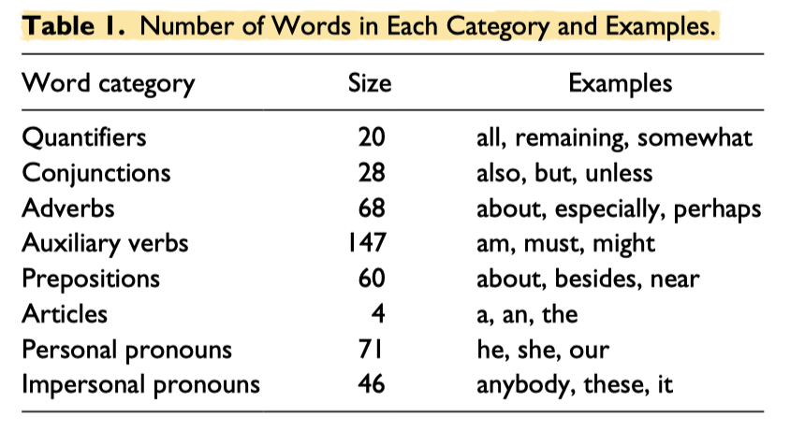
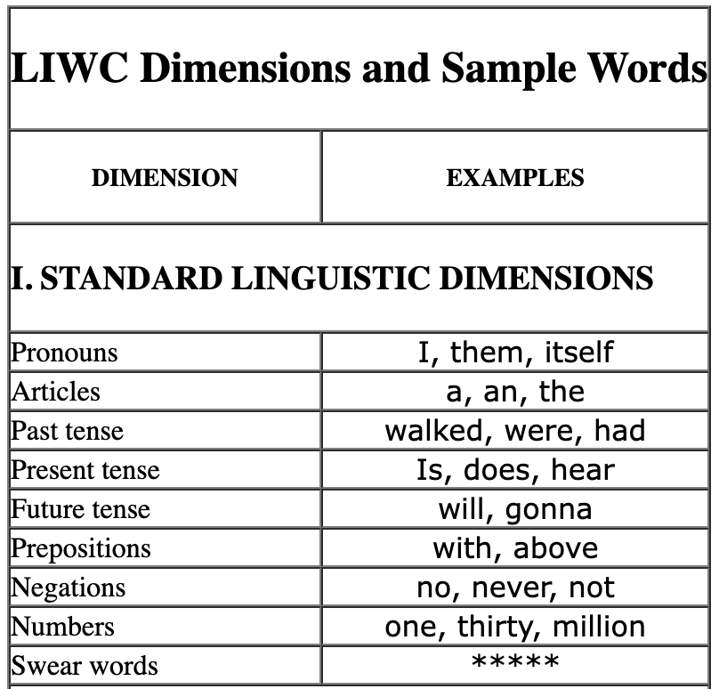
8 LIWC Categories for Measuring LSM
Function words, not content words, carry style.
https://www.liwc.app/
https://www.liwc.app/help/lsm

Slide 53
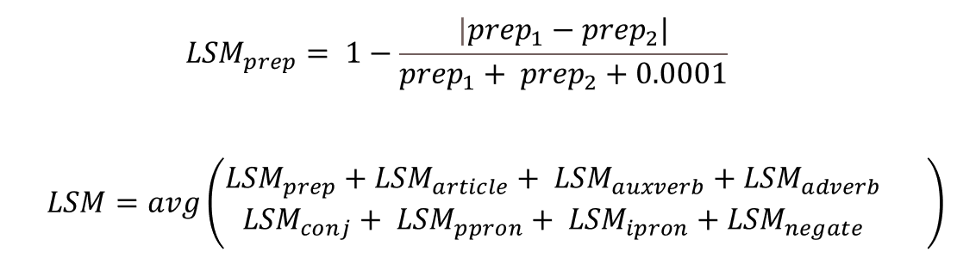
LSM Formula
Where:
- c₁ = proportion of category c words used by speaker 1
- c₂ = proportion of category c words used by speaker 2
- eps = small constant to avoid division by zero; e.g., 0.0001
- The overall LSM is the mean of the 8 category-level scores.
Range: 0 (no matching) to 1 (perfect matching)
Interpretation:
- LSM > 0.85 = high matching
- LSM 0.70 - 0.85 = moderate
- LSM < 0.70 = low matching

Slide 54
Computing LSM Step by Step
Step 1: Split each speaker's text into tokens
Step 2: Count words per LIWC category
Step 3: Convert counts to proportions
Step 4: Compute category-level LSM
Step 5: Average across the nine categories
Result: A single LSM score for the exchange.
Shall we do text pre-processing like remove stopwords?

Slide 55
Example - Simplified LSM
Speaker A: "I think our plan is good, we can do it."
Speaker B: "I agree, and we should act now."
Personal pronouns category (I, we, our):
- A: 3 / 10 = 0.30
- B: 2 / 7 = 0.29
LSMc = 1 - ( |0.30 - 0.29| / (0.30 + 0.29) ) = 0.983

Slide 56
Applying LSM to Social Media
Research ideas:
- Twitter debates: LSM between candidate replies
- Q&A sites: LSM between askers and top answers (picked)
- Customer service: LSM between agent and customer messages
- Online communities: LSM within subreddit posts / threads over time

Slide 57
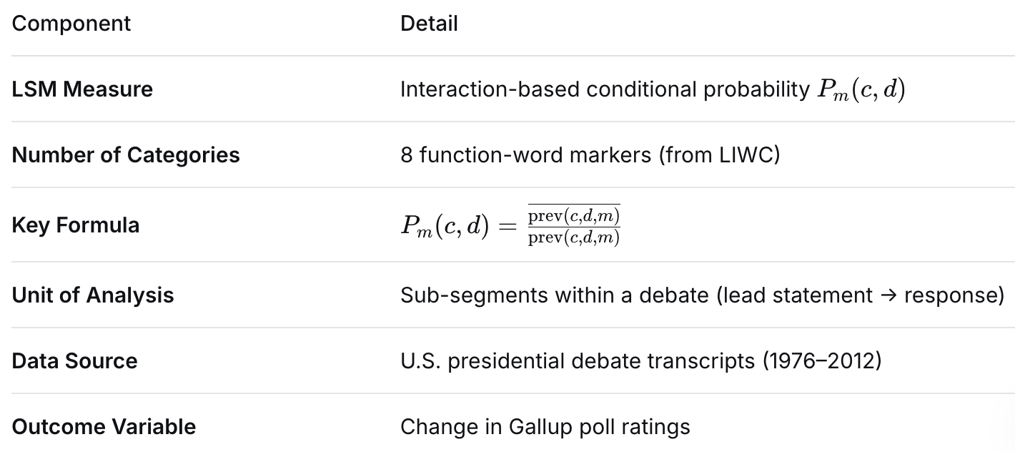
LSM variations
Data: All transcribed U.S. presidential debates between 1976 and 2012 and third-party evaluations (i.e., subsequent poll ratings).
Romero et al. (2015). Mimicry Is Presidential. Personality and Social Psychology Bulletin.
Notes:
The Segmentation Procedure
To operationalize this, the full debate is segmented into sub-segments where there is a lead statement (a question or a statement by a participant). Each lead statement is rated for the linguistic markers, and the response statement by the next candidate is categorized as either containing the marker or not. This is done for all sub-segments across the entire debate
prev(c,d,m): The total number of times the person who spoke right before $c$ used marker $m$.
$\overset{‾}{\text{prev}\left(c , d , m\right)}$: The number of times candidate $c$used marker $m$and the previous speaker also used that marker.
This ratio is only calculated when the denominator is greater than zero.

Slide 58
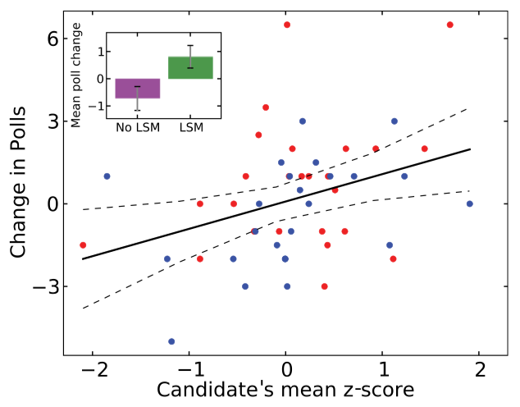
LSM predicts election polls
Data: All transcribed U.S. presidential debates between 1976 and 2012 and third-party evaluations (i.e., subsequent poll ratings).
Finding: High LSM is linked with candidate’s subsequent poll increase.
Romero et al. (2015). Mimicry Is Presidential. Personality and Social Psychology Bulletin.

Slide 59
Sentiment Analysis
Attempt to identify affective state of text with NLP methods.
How do we measure sentiment (score or category)?
At what level? Word or sentence?

Slide 60
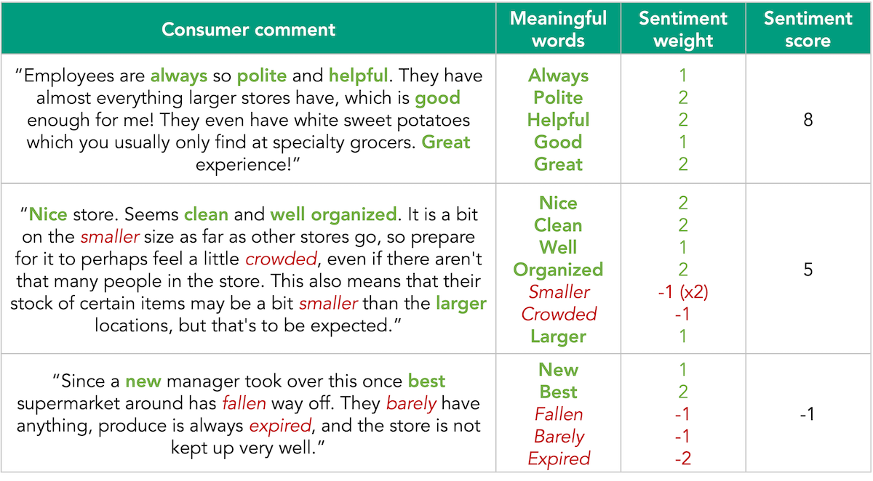
Sentiment Analysis
Lexicon-based approach
Lexicon: each word is assigned a sentiment score.
Sum sentiment score of all words in the given text.

Slide 61
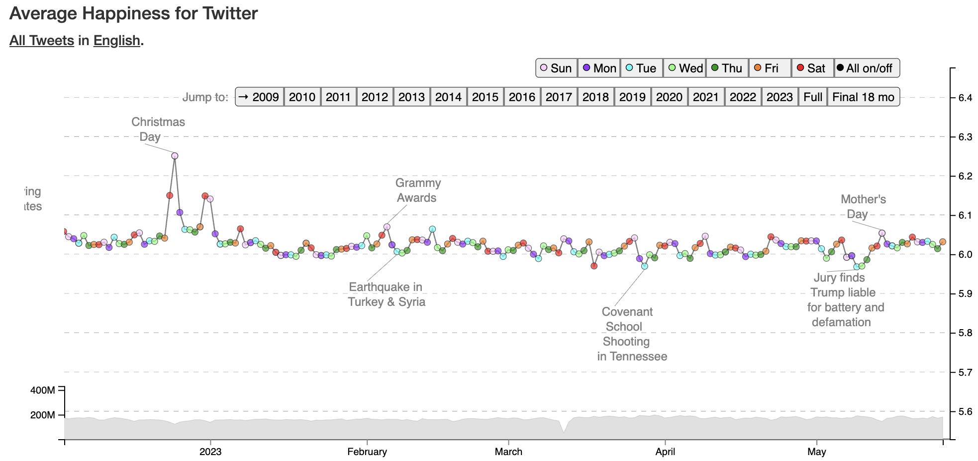
Hedonometer of happiness
https://hedonometer.org/timeseries/en_all/?from=2022-12-03&to=2023-05-26&viz=wordshift

Slide 62
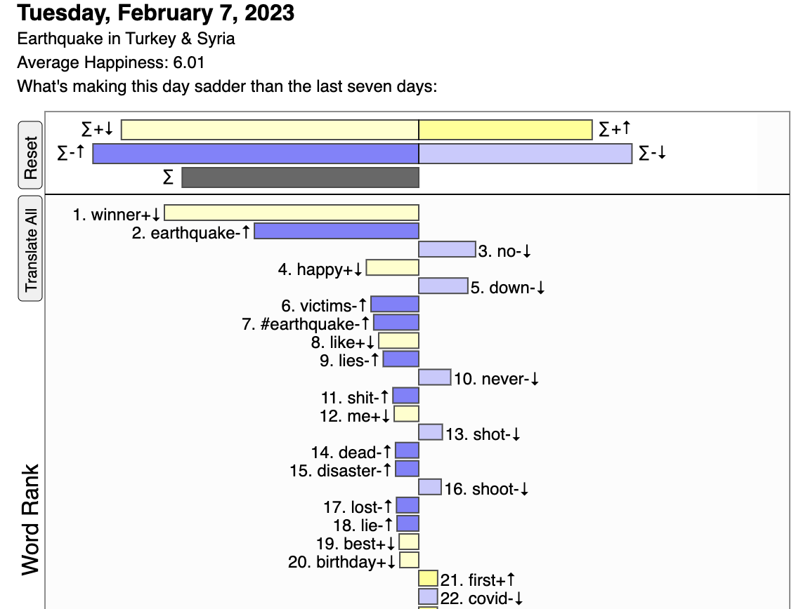
Measured via word change

Slide 63
Exercise 1 - Hashtag and Mention Extraction
"Big thanks to @nytimes and @washingtonpost for covering #ClimateAction and #GreenEnergy. Follow @UN for updates. #ActOnClimate"
Deliverables:
- List of hashtags
- List of mentions
- Count of unique accounts mentioned

Slide 64
Exercise 2 - Compute Simplified LSM
Speaker A: "I think we should act, and I mean now."
Speaker B: "Trump agrees, and the party supports the plan."
Deliverables:
- Proportions of personal pronouns for each speaker
- LSM score for the personal pronoun category
- Interpretation of the result (high, moderate, low)

Slide 65
Course Notes
“NLP Models in SMA” next week
  Recap on LIWC, LDA features
  Word2vec, Doc2vec
  Emotion, Language detection, Fake news
Tutorial next week
  Predict user attributes using NLP models
  TF-IDF (baseline), LIWC, LDA, W2v
  Regression vs. Classification
Homework 1 will be released next week
  Due in two weeks!

